Slide 1
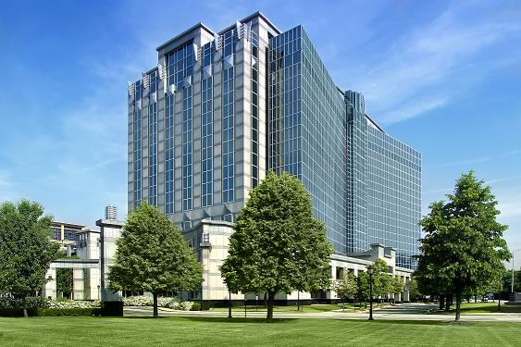
One O’Hare Centre
One O’Hare Centre
Tenant Relations & Retention Program

Slide 2
ONE O’HARE CENTRE
One O’Hare Centre is a Class A trophy tower offering strategic location, superior architecture and unparalleled amenities. One O’Hare Centre is in the heart of the O’Hare suburban office submarket. The building is considered one of Chicago’s premier suburban office assets and represents 3 percent of the total 13.8 million square feet of office inventory. The iconic building offers exclusive amenities, convenient access to Chicago’s transportation network and close proximity to O’Hare International Airport and the CTA.
Tenants here enjoy CBRE Investors’ exclusive tenant services program, 5-Star Worldwide. The program offers tenants a brand-new executive meeting room and tenant lounge, an upgraded Wellness Center and resources for event planning, travel arrangements and more.

Slide 3
Introduction and Purpose
Providing the highest level of service to our Tenants is the cornerstone to the 5-Star culture of CBRE Global Investors.
It is recognized in the marketplace as the differentiator between us and our competition.
The purpose in developing this Tenant Relations and Retention Program is to formalize what we do to achieve superior Tenant Satisfaction.
We have learned through our Kingsley Surveys that there is a direct correlation between high levels of Tenant Satisfaction and the increased likelihood of renewal intentions by our Tenants.

Slide 5
Management Team
Kevin Halm Real Estate Manager
Stacy Schannon Assistant Real Estate Manager
Joanna Scianna 5-Star Worldwide Manager
Guy Monzel Chief Engineer
Chris Heramb Engineer
Terry Stel Security Supervisor
Our Goal…
Provide the highest level of service to our Tenants
“LEAP” (Listen, Empathize, Ask, Produce) to Tenant issues
Use the CBRE “RISE” Values (Respect, Integrity, Service, Excellence)

Slide 6
Tenant Relations & Retention Program
Tenant Amenities
Services
Outreach
Events
Resources

Slide 7
Tenant Amenities
5-Star Conference Center
-3 Different Room Size Options
-State Of The Art Technology
Wellness Center (Operated by Unicus Fitness)
-Corporate Wellness Programs
-Daily Group Classes
-Private Personal Training
-Small Group Training
-Nutritional Programs
-Locker Room Toiletries & Complementary Towel Service
Shuttle Service To/From CTA, O’Hare International Airport, and Local Area Attractions
24/7 Manned Security
Onsite Dining-The Bistro Café
Sundry Shop
Tenant Lounge
ATM
US Postal, UPS, and FedEx Drop Off
Vending Machines

Slide 8
5-Star Conference Center
5-Star Worldwide, our signature tenant services program, offers an impressive selection of premier amenities and resources, including full even-planning assistance from our 5-Star Worldwide Manager.
Our program is designed to handle the details of your day so you can focus on your event. Whether you’re closing deals, delivering game changing presentations or hosting unforgettable luncheons. We’re here to help.
All customized, all complimentary.
-Full Event planning support
-Room set-up and AV/technical support
-Coordinating caterers and other vendors
-Reservations for transportation to the event or dining afterwards.

Slide 9
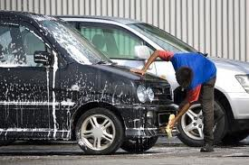
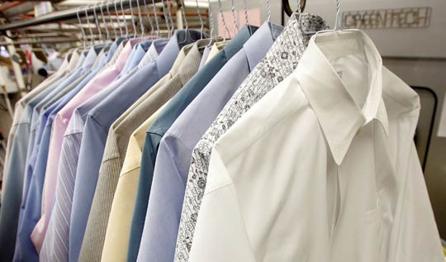
Services
Complimentary Concierge Services
Complimentary Notary
Dry Cleaning
Onsite Car Wash
Discounted Car Rental and Limo Services
Discounted Hotel Rates
Shoe Shine Service

Slide 10
Outreach
Quarterly Contact Meetings
Manager Lunch Program
Lobby Digital Stand
Newsletters
Event Emails
Building Event Signage

Slide 11
2014 Events
Tenant Appreciation Events
February Valentine’s Day (Sweet Treats)
April Earth Day
June Summer BBQ
July Ice Cream Social
October Halloween, Pumpkin Carving Contest
November Turkey Raffle
December Holiday Lunch
Charitable Events
Flu Shots by Flu Ease
Blood Drives by Heartland Blood Center
Spinal Examination by Higgins Sports & Spinal Rehab
Shoe Drive benefiting Soles4Souls
Toy Drive benefiting Salvation Army
Food Drive benefiting The Greater Chicago Food Depository
School Supplies Drive benefiting Walter & Connie Payton Foundation

Slide 12
Tenant Relations
“5-Star Service Worldwide” Candy Dish to Each Tenant
-Weekly Candy Drops
Tenant Contact Breakfasts
Tenant Lunch & Learns
-Fitness & Nutritional
-Financial Seminars
-Safety First
Holiday Gift Baskets
Raffles/Contests
-Guess how many pieces of candy in the jar
-Guess the weight of the giant pumpkin
-Turkey raffle
Team Building Events
Milestone Anniversary Gifts

Slide 13
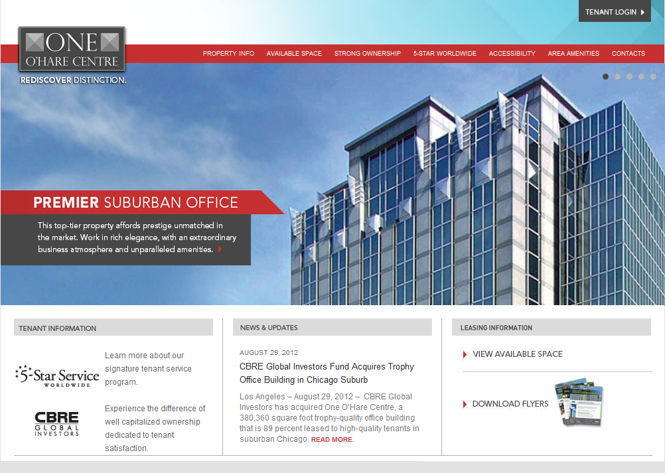
Resources
Tenant Welcome Binder
On-Line Work Order System: Angus through the Axis Portal
Building Website
www.oneoharecentre.com
Leasing Information
Building Events Calendar
Newsletter
Building Forms
Weather Report
Traffic Report

Slide 14
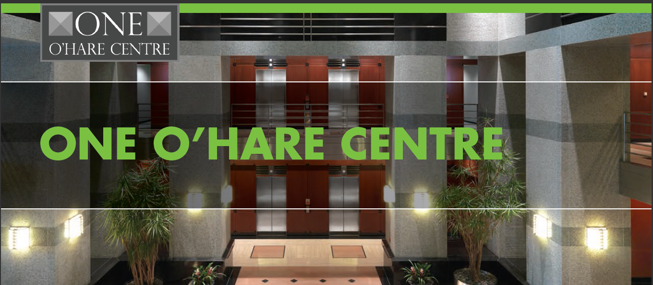
Rediscover Distinction

