Slide 1
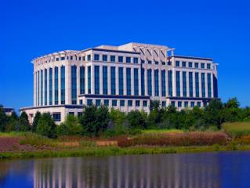
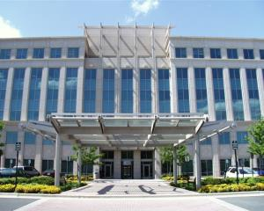
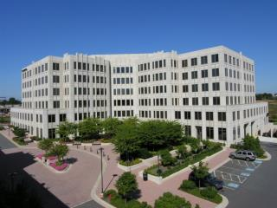
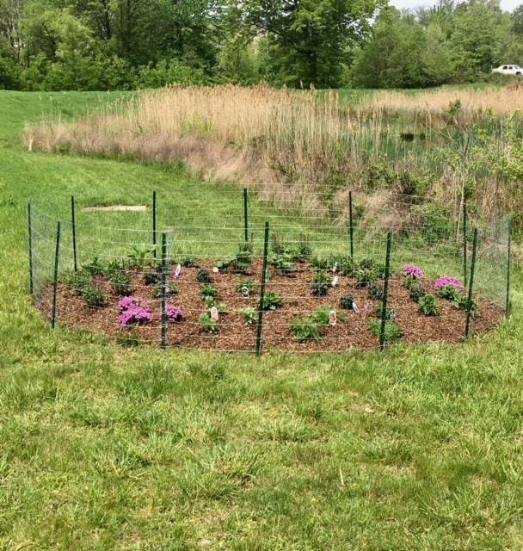
Irvington Centre
Tenant Relations Program
CBRE’s Commitment to 5 STAR Service
The Tenant Relations Program is a important part of our Tenant Retention Plan at Irvington Centre. As part of our Tenant Relations Program, the management team hosts monthly events for tenant employees, most which are low or no cost. These events help foster relationships with all tenants and their employees who we may not interact with on a daily basis. Management also partners with tenants on various projects to help meet their corporate and sustainability initiatives.
Client
Baylor Health Care System
2017 Tenant Relations Spotlight
Bee and Butterfly Garden
Bees are dying at an alarming rate. Many plants rely on bees to produce some of nature’s most beloved foods, including coffee, however due to the use of pesticides and climate change many pollinators like bees are disappearing. The sustainability team at Avendra (a tenant at 702 King Farm) asked management to partner with them to create a butterfly and bee garden on the property. We provided the location and they provided the materials to create the garden. The plants in the garden are perennials, and management pledged to prune the garden every spring so our butterflies and bees will return.

Slide 2
Irvington Centre Tenant Relations Program
Valentines Day
Assortment of Cupcakes, Cookies and Fruit
Event Details
For Valentines Day, management held a afternoon snack in the lobbies of 700, 702 and 800 King Farm. Tenant employees were welcomed to come down for a afternoon treat (“while supplies lasts”).

Slide 3
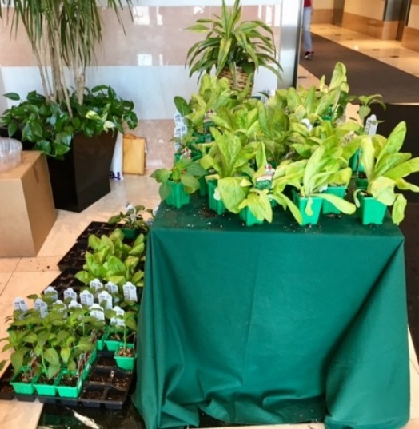
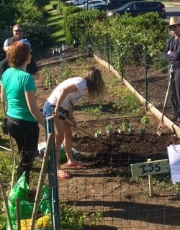
Irvington Centre Tenant Relations Program
Earth Day
Garden Vegetables For Home or the Community Garden
Event Details
As part of Irvington Centre’s commitment to sustainability, tenant employees received garden vegetables on Earth Day (donated by our exterior landscape provider) to grow at home or at the community garden.

Slide 4
Irvington Centre Tenant Relations Program
Opening Day
Ice cream and Vendor Sponsored Raffles
Event Details
To celebrate the Washington Nationals Opening Day, management held a Opening Day ice cream social. Tenant employees enjoyed ice cream in Washington National helmet cups in the conference centers at 702 and 800 King Farm . Tenants were able to enjoy their ice cream while watching the game in the newly renovated conference center at 702 King Farm. Tickets to future Washington National games were donated by service providers and raffled to tenant employees.

Slide 5
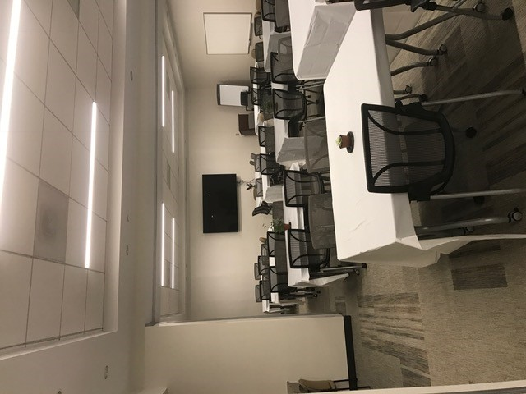
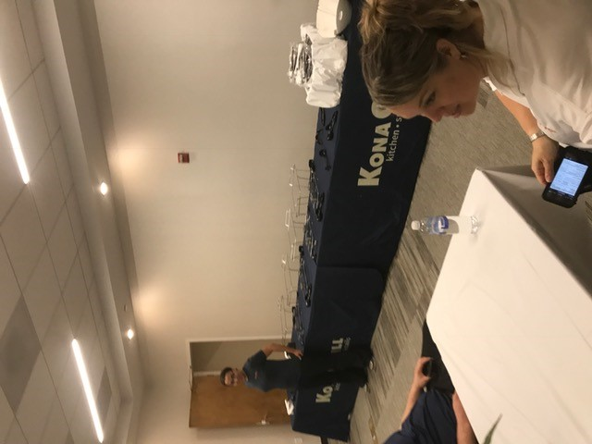
Irvington Centre Tenant Relations Program
Mother’s Day Luncheon
Lunch for All Tenant Employees
Event Details
The Mother’s Day luncheon was a huge hit at Irvington Centre. The conference centers at 702 and 800 King Farm were turned into dining rooms and tenant employees were invited to enjoy a light lunch buffet.

Slide 6
Irvington Centre Tenant Relations Program
Donuts for Dads
Donuts for All Tenant Employees
Event Details
To celebrate Father’s Day, tenant employees were greeted in the lobbies of 700, 702 and 800 King Farm by the CBRE Management team with an assortment of donuts. Tenants were able to grab a donut on the go or enjoy them in the lobby with other tenant employees.

Slide 7
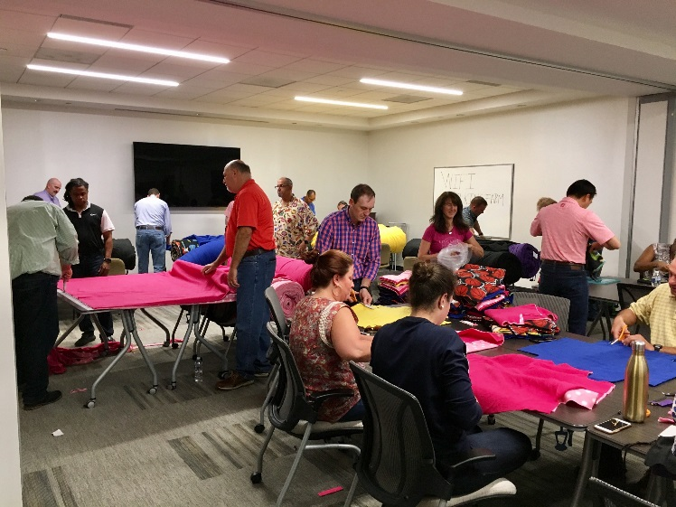
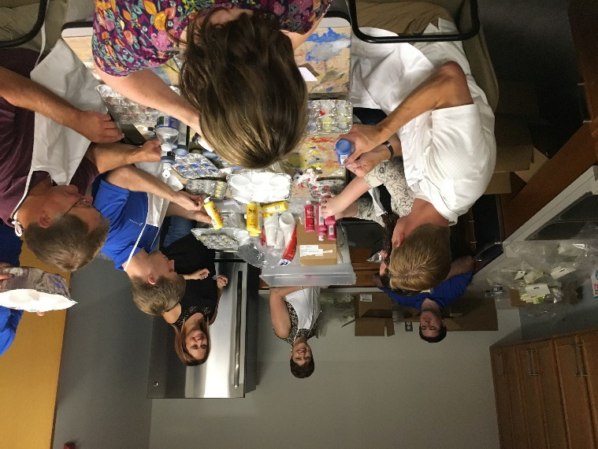
Irvington Centre Tenant Relations Program
Anna’s Gift Foundation
Arts & Craft Project
Event Details
Tenant employees at 702 spent time during their day to create arts and craft projects to deliver to hospitals for children undergoing extensive medical treatments.

Slide 8
Irvington Centre Tenant Relations Program
Puerto Rico Relief
Collection Drive
Event Details
CBRE partnered with Embrace Home Loans, tenant at 800 King Farm, to hold a collection drive to benefit the victims of Hurricane Maria in Puerto Rico. Donation bins were placed in the lobby at 800 King Farm and tenants from 700, 702 and 800 King Farm donated toiletries, canned foods and emergencies supplies.

Slide 9
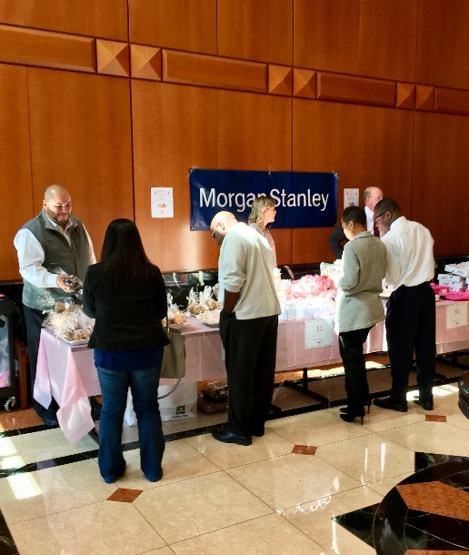
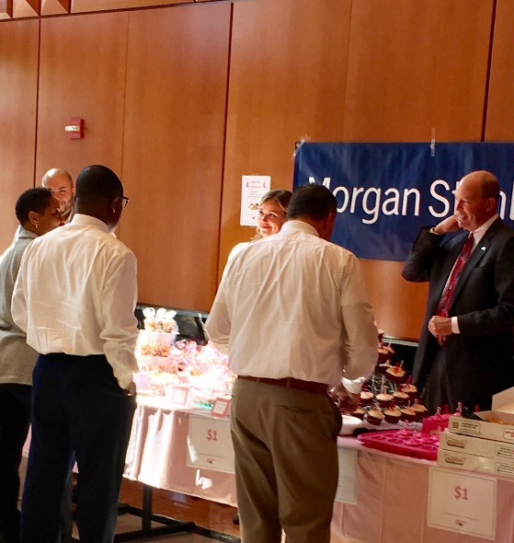
Irvington Centre Tenant Relations Program
Breast Cancer Awareness
Bake Sale Fundraiser
Event Details
In recognition of Breast Cancer Awareness Month, CBRE partnered with Morgan Stanley, tenant at 702 King Farm, to hold a bake sale fundraiser to raise money for breast cancer research. $879.00 was raised and the proceeds were sent to the American Cancer Society!

